Slide 1

Census Has Business Data?
An Overview of Key Economic Data for New York (including COVID data)
NY SDC Annual Meeting
September 29th, 2021
Presented by: Andrew W. Hait
U.S. Census Bureau
NY SDC webinar | Sept 2021| 1

Slide 2
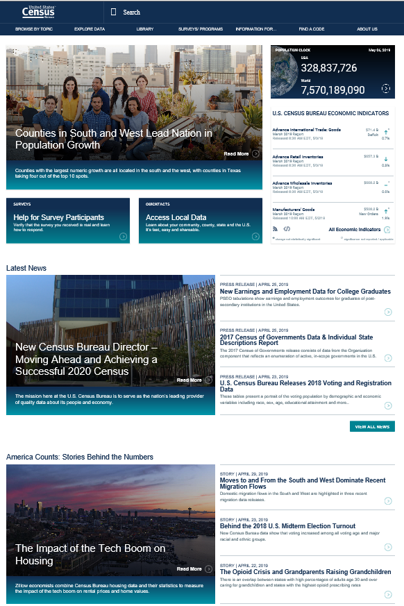
About the Census Bureau
The U.S. Census Bureau is the federal government’s largest statistical agency.
We conduct more than 130 censuses and surveys each year, including
  The Decennial Census – the once-a-decade population and housing count of the United States
  The American Community Survey – the ongoing annual survey of the nation’s population
  The Census of Governments – identifies the scope and nature of the nation's state and local government sector
  The Economic Census – the official five-year measure of American business
Our mission is to serve as the leading source of quality data about America’s people, places, and economy.
https://www.census.gov/
NY SDC webinar | Sept 2021| 2

Slide 3

Monthly
and Quarterly
Surveys
Annual Surveys
Economic Census – Every 5 years
Census Economic Surveys
Census Bureau Economic Surveys are a key source for official statistics companies can use:
  Monthly and Quarterly are small sample surveys that provide the most TIMELY data available
  Annual surveys have larger samples and provide the most up-to-date TREND data available
  Every 5 years, the Economic Census measures all businesses and provides the most COMPREHENSIVE data available
These surveys set the standard for U.S. economic statistics, and are fueled by the data provided by individual businesses
NY SDC webinar | Sept 2021| 3

Slide 4
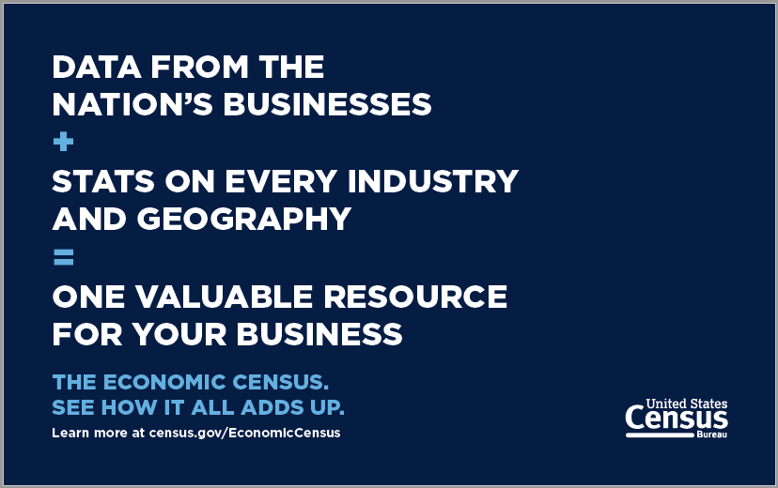
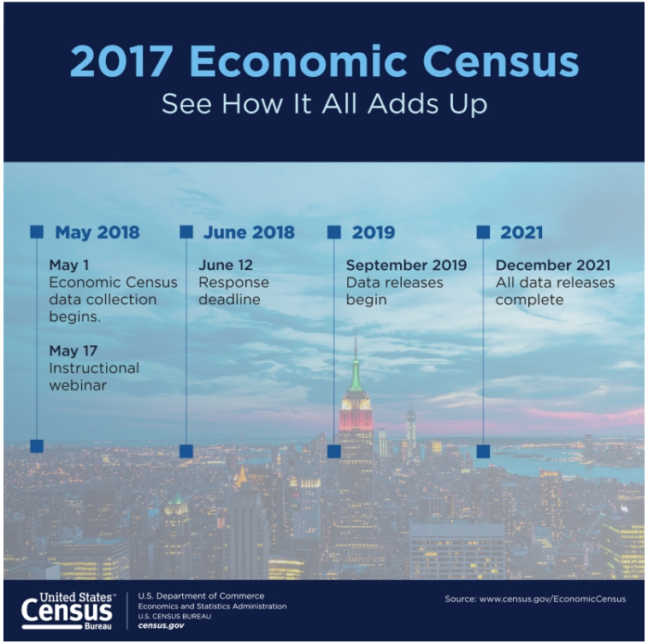
The Economic Census (EC)
NAICS: Every 2- thru 6-digit code covered by the Census Bureau
Geography: Provides data at the national, state, metro area, county, and place levels
Other Dimensions: Data by business size, Franchise status, etc.
Over 200 data variables shown, including variables like the number of establishments, employment, payroll, and sales plus sector-specific variables (inventories, assets, expenses, etc.)
Product Lines data
Released on data.census.gov, Census Business Builder, and other Census tools
Browse recorded webinars on the EC at https://www.census.gov/data/academy/webinars.html
NY SDC webinar | Sept 2021| 4
Notes:
Covers almost 8 million employer businesses… excludes nonemployers (which are insignificant in some industries in this sector but NOT others!)

Slide 5
Selected Economic Census Links for NY
Core Stats by Industry and Geography: https://data.census.gov/cedsci/table?g=0400000US36&y=2017&d=ECN%20Core%20Statistics%20Summary%20Statistics%20for%20the%20U.S.,%20States,%20and%20Selected%20Geographies%3A%202017&tid=ECNBASIC2017.EC1700BASIC
Industry by Products: https://data.census.gov/cedsci/table?q=&g=0400000US36&y=2017&d=ECN%20Core%20Statistics%20Economic%20Census&tid=ECNNAPCSIND2017.EC1700NAPCSINDPRD
Comparative (NEW): https://data.census.gov/cedsci/table?g=0400000US36&y=2017&d=ECN%20Core%20Statistics%20All%20Sectors%3A%20Comparative%20Statistics%20for%20the%20U.S.,%20States,%20and%20Selected%20Geographies%20%28Previous%20NAICS%20Basis%29&tid=ECNCOMP2017.EC1700COMP
Franchise (NEW): https://data.census.gov/cedsci/table?g=0400000US36&y=2017&d=ECN%20Core%20Statistics%20Selected%20Sectors%3A%20Franchise%20Status%20for%20the%20U.S.%20and%20States&tid=ECNFRAN2017.EC1700FRAN
16 Additional Sector-Specific Tables
NY SDC webinar | Sept 2021| 5
Notes:
Just compled GAS releases on 8/20… EARLY!

Slide 6
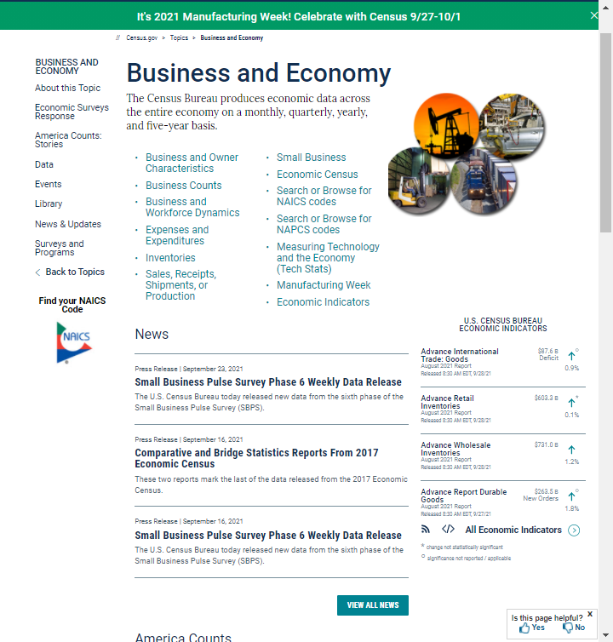
Annual Economic Programs
20 Census Bureau surveys that provide annual economic statistics for nearly every sector
Sample surveys or administrative data
Shown primarily at the national level, except:
  County Business Patterns (CBP): National, State, Metro, County, ZIP Code, Congressional District
  Nonemployer Statistics (NES): National, State, Metro, County
  Business Dynamics Statistics (BDS): National and State
  Commodity Flow Survey: National, State, and CFS Metros
  Annual Survey of Manufacturers: National and State
Other Related Annual Programs, including Retail eCommerce Sales (E-Stats) and Annual Capital Expenditures Survey
Released on data.census.gov, QuickFacts, CBB, and other Census tools
Notes:
CBP and NES should be your first go-to programs with businesses and orgs… but remind them that there is no sales data in CBP. Need to go to EC for that.

Slide 7
Selected CBP, NES, and BDS Links for NY
CBP
  Number of Establishments, Employment and Payroll by Industry, Geography, Employment Size of Establishments, and Legal Form of Organization: https://data.census.gov/cedsci/table?g=0400000US36&y=2019&d=ECNSVY%20Business%20Patterns%20County%20Business%20Patterns&tid=CBP2019.CB1900CBP
NES
  Number of Firms and Sales by Industry, Geography, and Sales Size: https://data.census.gov/cedsci/table?g=0400000US36&y=2018&d=ECNSVY%20Nonemployer%20Statistics&tid=NONEMP2018.NS1800NONEMP
BDS
  Number of Firms and Establishments and Employment by Industry, Geography, and Establishment Age: https://data.census.gov/cedsci/table?g=0400000US36&y=2018&d=ECNSVY%20Business%20Dynamics%20Statistics&tid=BDSTIMESERIES.BDSEAGE
  12 Additional Tables, including ones by Firm Age, Size, and Initial Size
NY SDC webinar | Sept 2021| 7
Notes:
Just compled GAS releases on 8/20… EARLY!

Slide 8
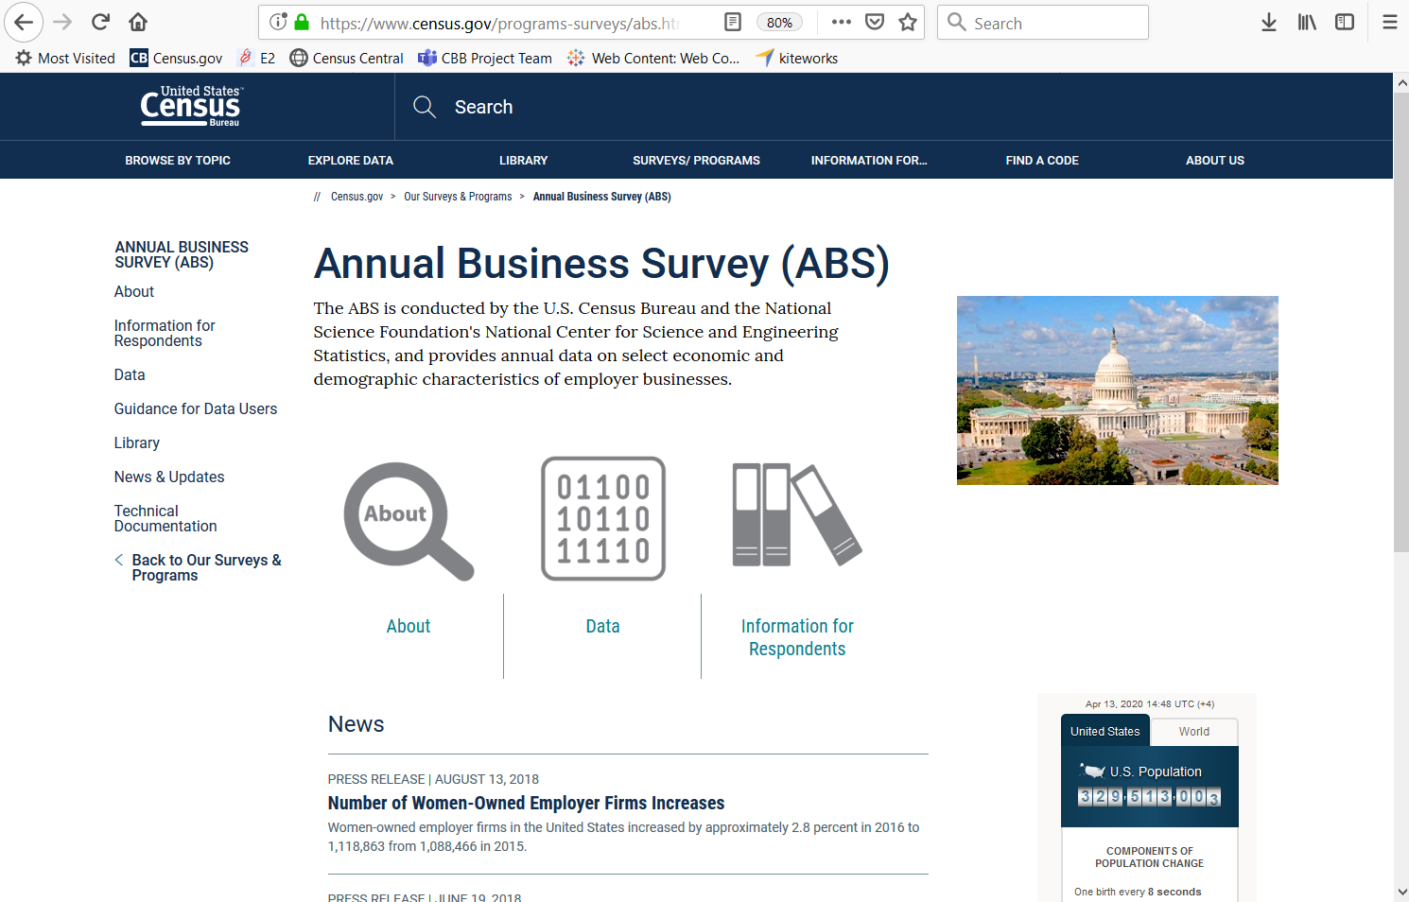
Annual Business Survey
Provides data on business ownership by race, ethnicity, gender, and veteran status for employer businesses
NAICS
  EC Years: 2-6 Digits
  Other Years: 00
Geographies
  EC Years: Nation, State, Metro, County, and Place
  Other Years: Nation, State, and Metro
https://www.census.gov/programs-surveys/abs.html
NY SDC webinar | Sept 2021| 8

Slide 9
Selected ABS Links for NY
Basic Stats by Industry and Geography by Race/Ethnicity/Gender/Veteran: https://data.census.gov/cedsci/table?g=0400000US36&y=2018&d=ECNSVY%20Annual%20Business%20Survey%20Annual%20Business%20Survey&tid=ABSCS2018.AB1800CSA01
Basic Stats by Industry and Geography by Race/Ethnicity/Gender/Veteran and Years in Business: https://data.census.gov/cedsci/table?g=0400000US36&y=2018&d=ECNSVY%20Annual%20Business%20Survey%20Annual%20Business%20Survey&tid=ABSCS2018.AB1800CSA02
Basic Stats by Industry and Geography by Race/Ethnicity/Gender/Veteran and Receipts Size: https://data.census.gov/cedsci/table?g=0400000US36&y=2018&d=ECNSVY%20Annual%20Business%20Survey%20Annual%20Business%20Survey&tid=ABSCS2018.AB1800CSA03
Basic Stats by Industry and Geography by Race/Ethnicity/Gender/Veteran and Employment Size: https://data.census.gov/cedsci/table?g=0400000US36&y=2018&d=ECNSVY%20Annual%20Business%20Survey%20Annual%20Business%20Survey&tid=ABSCS2018.AB1800CSA04
22 Additional Tables, including ones on both Business and Owner Characteristics and a number of ones on Technology
NY SDC webinar | Sept 2021| 9
Notes:
Just compled GAS releases on 8/20… EARLY!

Slide 10
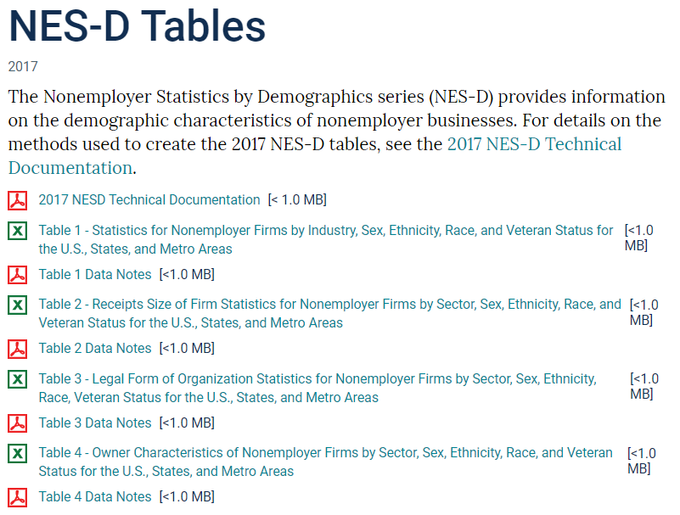
The Nonemployer Statistics – Demographics Program
Enhances the ABS by providing annual data on the demographic characteristics of nonemployer businesses
Data on business ownership by race, ethnicity, gender, and veteran status for self-employed persons
Geographies
  Nation, State, and Metro by selected 2- thru 6-digit NAICS
Firm size and LFO data too
See https://www.census.gov/programs-surveys/abs/data/nesd.html

Slide 11
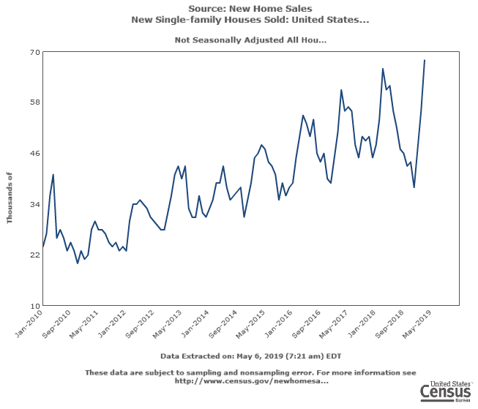
Economic Indicators
17 Census Bureau surveys that provide key economic statistics for nearly every sector
  Monthly, including:
    Retail Trade Survey, Building Permits, and Exports/Imports
  Quarterly, including:
    Quarterly Financial Report; Quarterly Services Survey
Sample surveys
Shown at the national level only, except:
  Building Permits (state, permit issuing areas)
  International Trade data
  Many new Experimental Data Products
Released on the Economic Indicators Briefing Room and FRED: www.census.gov/economic-indicators/index.php https://fred.stlouisfed.org/
How Can This Help Me?
Indicators provide most timely data that helps users understand changes since last annual program
Permits data help users “predict” future economic growth
Notes:
Indicators provided first glimpse into impacts of pandemic on businesses; SBPS adds more info

Slide 12
International Trade
A Census Bureau program that provide monthly and annual U.S. exports and imports statistics
Data reported via ACE AESDirect and Customs and Border Protection documents
Data shown at the national, state, district, and port levels
Data provided by NAICS (Ag, Mining, and Manufacturing sectors only), Commodity, and Country of origination and destination
Census Bureau also issues export regulations from the U.S.
See census.gov/foreign-trade/data/index.html and USA Trade Online (https://usatrade.census.gov/ ) for the data
Trade flyer
Notes:
Trade data a key source of info on potential markets
Census is the official source of this data (not ITA, USTR...)
Approx. 18,000 classification numbers used to classify imported and exported products (much more detailed then NAICS)

Slide 13
COVID Data and Tools
NY SDC webinar | Sept 2021| 13
Notes:
Just compled GAS releases on 8/20… EARLY!

Slide 14
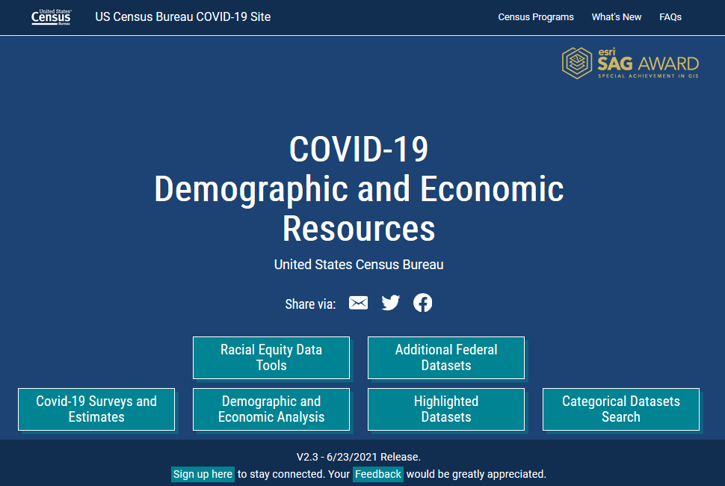
COVID-19 Hub
https://covid19.census.gov/
https://www.census.gov/topics/preparedness/events/pandemics/covid-19.html

Slide 15
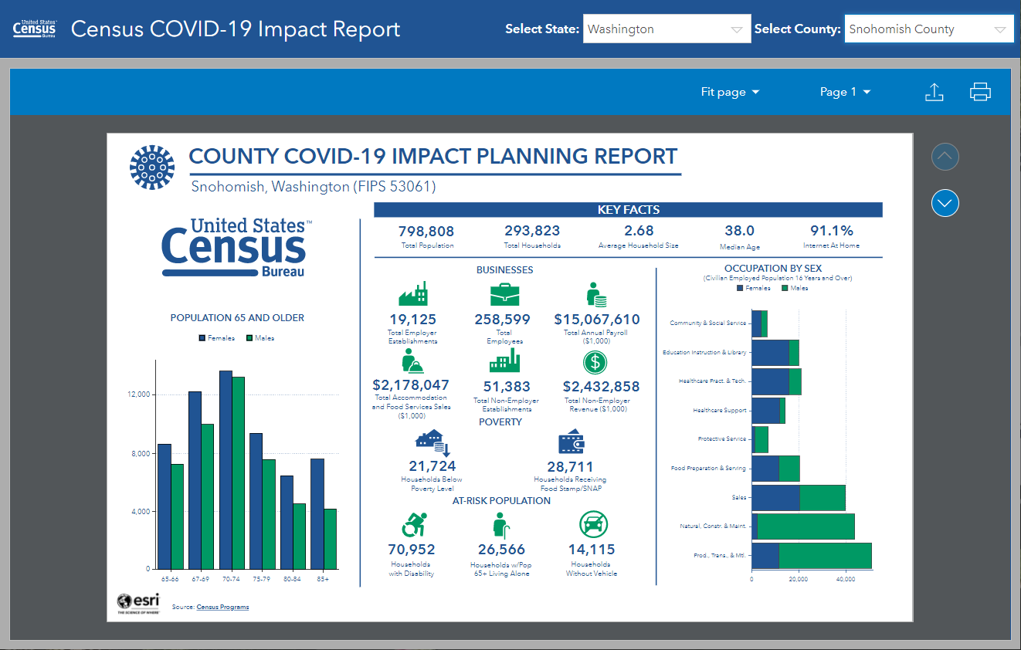
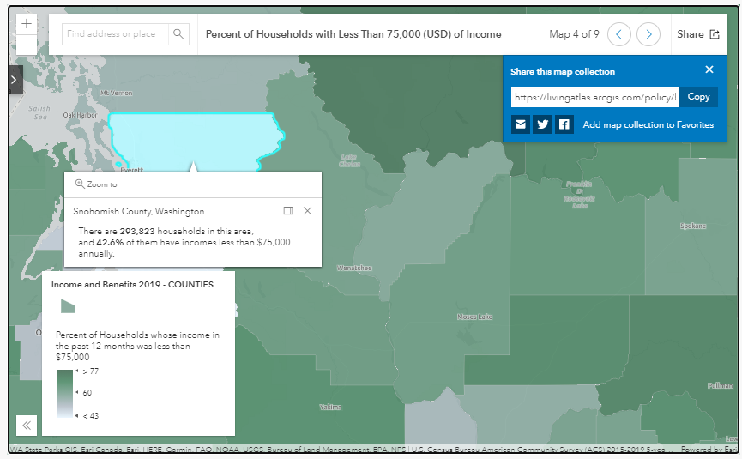
Interactive Dashboards and Policy Maps

Slide 16
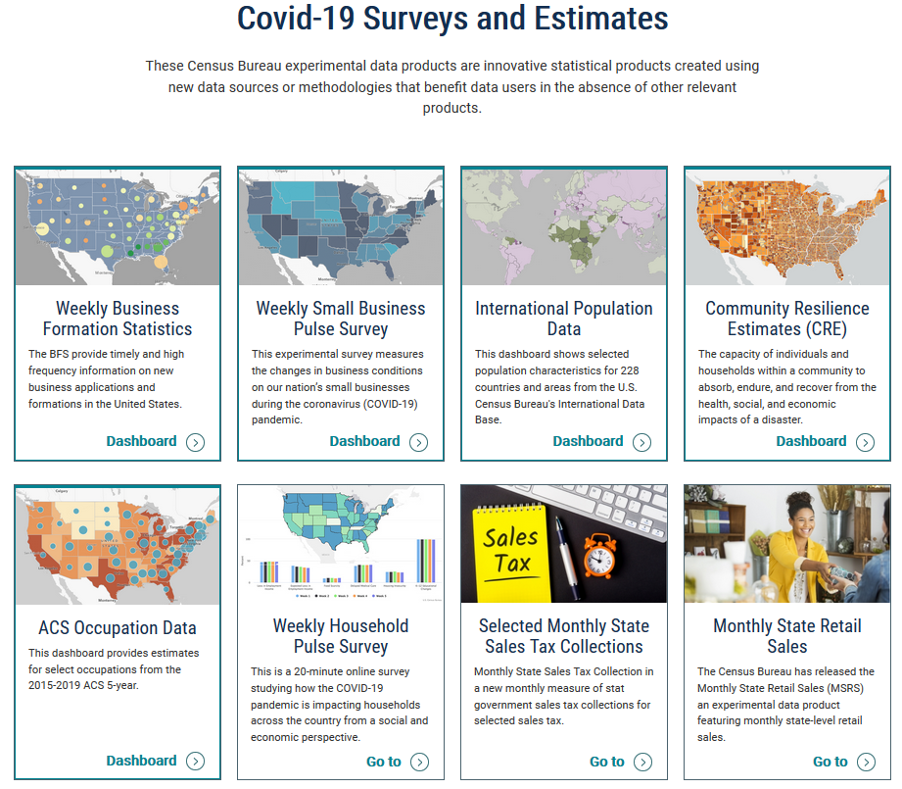
Access to Interactive Dashboards and Web Sites for COVID-Specific Programs

Slide 17
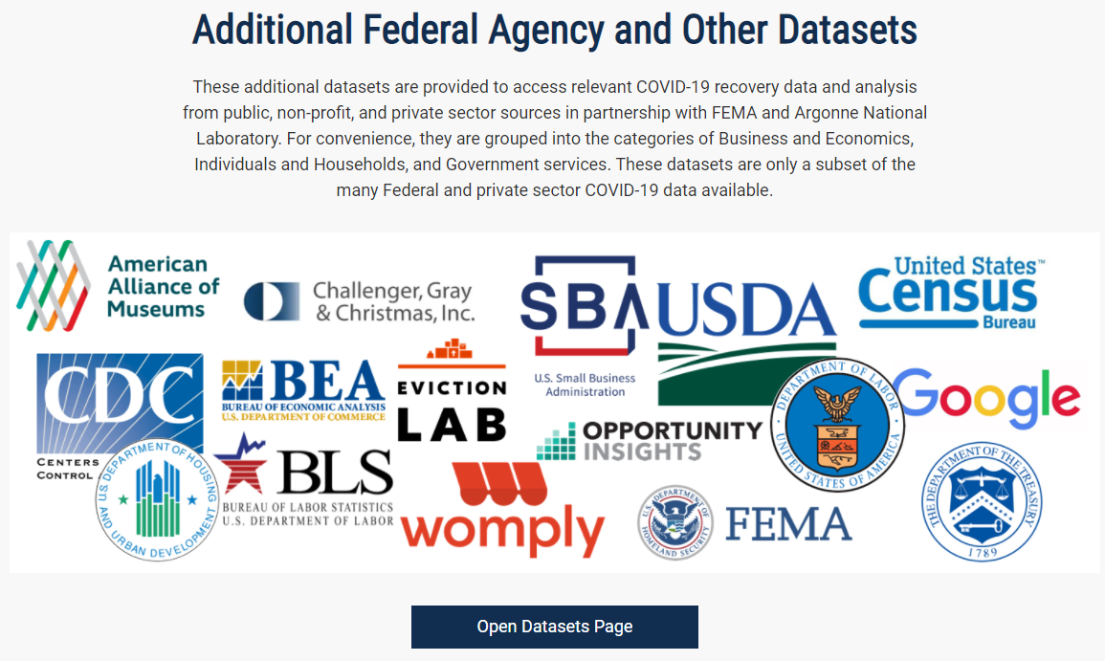
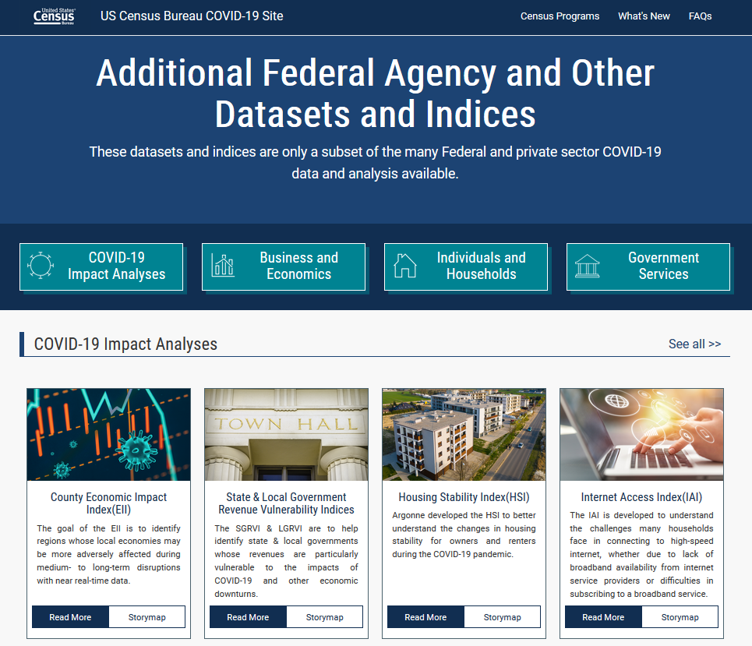
Additional Datasets
(Downloadable resources also available)
Notes:
This is the brand new part of the hub… access to other covid data. It’s just links… none of this data are actually on the Hub, but that might change…

Slide 18
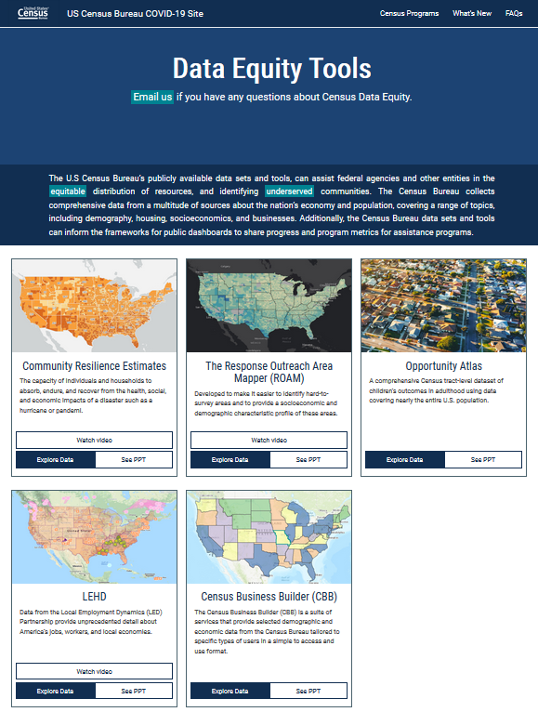
New Data Equity Tools
Provides links to 5 programs or data tools that can assist users equitably distribute resources to underserved communities
We Want Your Feedback!
What are we doing well?
What is the Hub missing that we should add?
How are you using this resource in your work?
Notes:
This is the brand new part of the hub… access to other covid data. It’s just links… none of this data are actually on the Hub, but that might change…

Slide 19
Census Business Builder
NY SDC webinar | Sept 2021| 19
Notes:
Just compled GAS releases on 8/20… EARLY!

Slide 20
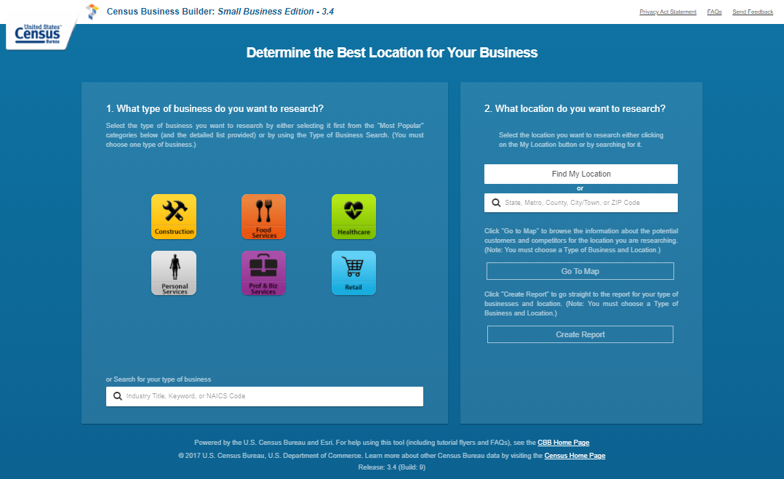
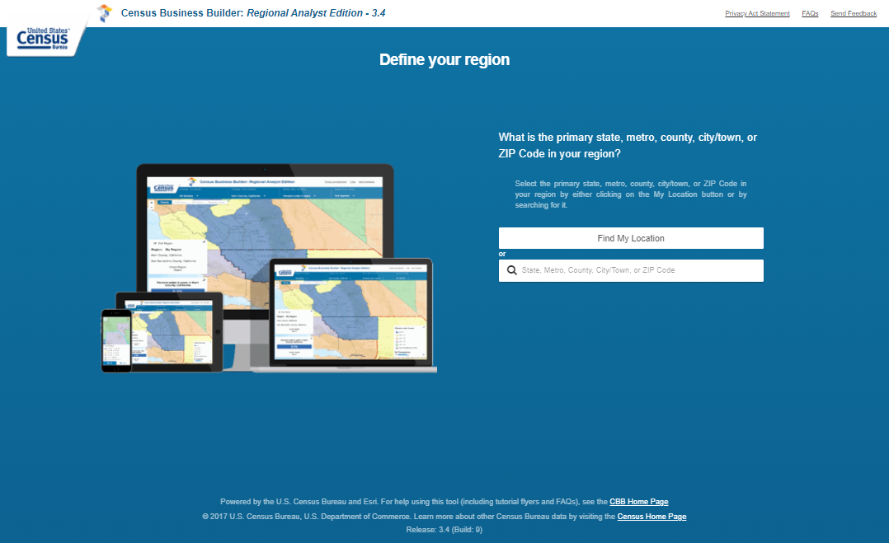
Guiding Principles
Easy to use
Customer focused
Provide access to Census data and more
  BLS, USDA, & third party
Leverage existing Census investments
  Esri, API
Use latest technology
  Cloud
Provide for free
Census Business Builder
CBB Home Page
https://www.census.gov/data/data-tools/cbb.html

Slide 21
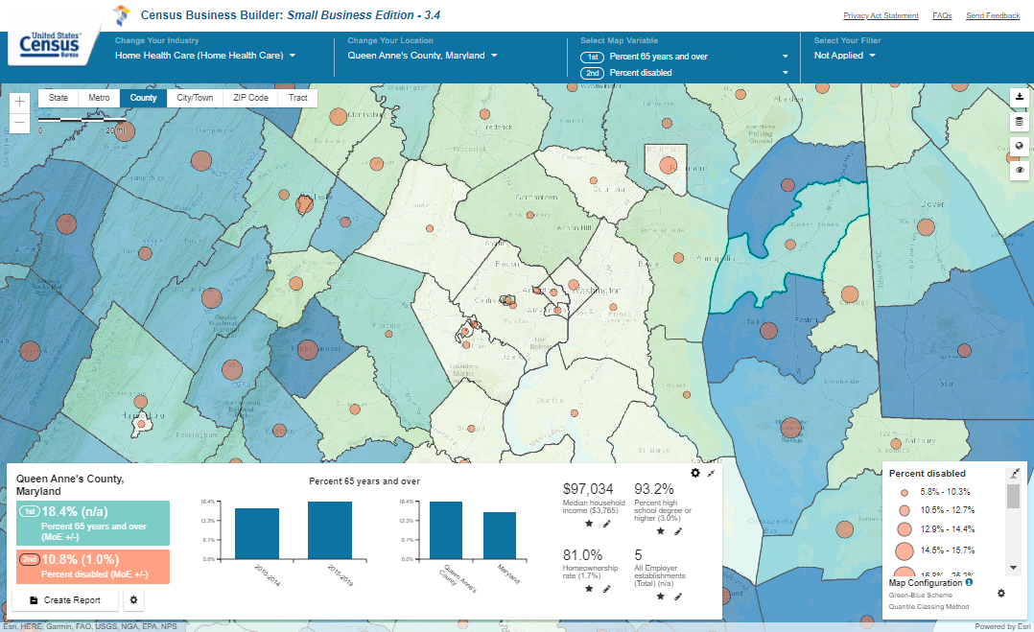
CBB: SBE “Map Page”
Change Industry Menu (3.4 Added Industry Cluster (SBE Only))
Change Geography Menu
Map Variables Menu (3.3 Added Bi-Variate Mapping)
Filter Menu
Geographic Levels Menu and Zoom Buttons (3.4 Added Metros)
Map Buttons
Map Legend (3.3 Update)
Map Dashboard
(3.3 Update)

Slide 22
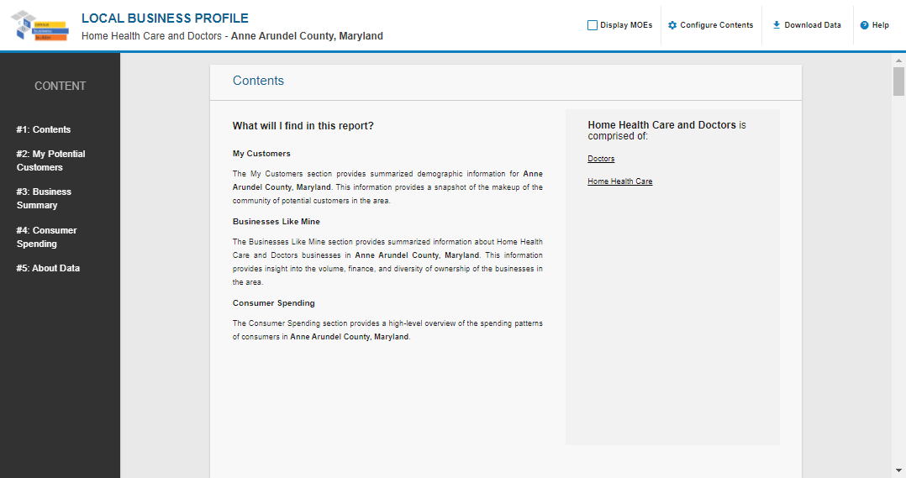
CBB: SBE Industry Cluster Report

Slide 23
What’s Coming in CBB 4.0+
Continue Quarterly Updates of Data
  QCEW and QWI
  Annual and other data as appropriate
Additional Data
  2020 Decennial Census
  More “mash-up” variables
Expanded Functionality
  Geo Ranking Charts
  Industry Cluster feature added to RAE
Other updates based on feedback

Slide 24




Q & A and Thank You!
Contact me at:
Andrew.W.Hait@census.gov
(301)763-6747
NY SDC webinar | Sept 2021| 24

