Slide 1
NYS Department of Labor Teacher Ambassador Program
Summer 2023
Lou DiCesare, Sue Sodoma, Nick D’Amuro
Rochester/Finger Lakes Region

Slide 2
Overview
DOL Market Research/Economic data regarding labor
DOL Services
Employer Interviews
Takeaways/Solutions
What is the DOL Teacher Ambassador Program?

Slide 3
What is the New York State Department of Labor Teacher Ambassador Program?
The program included:
30 teacher ambassadors from across the state selected to participate in the program
NYS Commissioner of Education and Department of Labor presented to 30 teachers emphasizing the importance of this program
Teams of three teacher ambassadors across the state were located at various DOL Career Centers

Slide 4
What is the New York State Department of Labor Teacher Ambassador Program?
Department of Labor Workforce Development teams and DOL leaders
Participated in informational meetings about the different divisions of the Department of Labor, professional development workshops, exposed to industry-specific career exploration, and career-related skill development
Visited and went on tours of businesses that have a high demand for many jobs requiring all different levels of education
Teacher Ambassadors
Collaborated with each other to develop lesson plans and insights to industry needs that could be shared with their students/local districts

Slide 5
What is the New York State Department of Labor Teacher Ambassador Program?
Rationale behind the creation of the Teacher Ambassador Program
Data shows there currently is a labor shortage that will continue to grow with the aging workforce. The word epidemic was not used to describe the labor shortage, but this annual Ambassador program and other programs are being instituted to avoid needing to use this word. (Small example: 4,000 welders will retire in the Finger Lakes Region in the next five years)
Opportunities for high growth, high demand jobs that do not require a college education are enormous, but knowledge of these opportunities are low
The current young job seekers that do apply for are lacking basic skills to remain employed (terminated or quitting)

Slide 6
What the Rochester Region Teachers Experienced
Attended two weeks of professional development workshops with members of the Department of Labor to gain background information about the divisions of the department of labor and current NYS labor data
Met with NYS Commissioner of DOL and Commissioner of Department of Education to learn about their vision for the future and our role as Teacher Ambassadors
Met with DOL career counselors, workforce development employees and a variety of other employees in the DOL
Attended two job fairs
Toured/met virtually or in-person with 24 businesses throughout the Monroe and Surrounding Counties

Slide 7
Societal Challenge: Schools are graduating students based on standards guidelines set by NYSED. The common message from the 24 employers we visited shared that many of the students that are graduating from HS are not meeting minimum requirements for employment. “How do schools prepare students not only to be college and career ready, but ready for “life?” Chris White, Deputy Commissioner for Workforce Development

Slide 8
DOL Market Research
NYS DOL SURVEY - 2023
8,500 Businesses
20,200 Job Seekers
Attracting and retaining workers top challenge of businesses
Need new hires that want to work and have skills and endurance to continue to work. (Quitting due to not have “stamina” to work 8 hours and firing new hires due to lack of soft skills)

Slide 9
Hardest positions to fill

Slide 10
Common Skills Lacking Among New Employees (Technical & Non-Technical)

Slide 11
Workforce Relationship w/ Education

Slide 12
Training Desired - Statewide

Slide 13
Employment Trends in Finger Lakes Region

Slide 14
DOL Services
Business Service Reps of DOL are a great resource for graduating seniors looking to directly entering the workforce
Rochester Works – Disability Services: First step to connect 18-year-old students with any diagnosed disability to resources and services to help get employed
ACCES VR – NYSED Program supporting students with disabilities to connect them to employment (https://www.acces.nysed.gov/vr , https://vimeo.com/483375715)

Slide 15
DOL Services
DOL Career Centers open to anyone looking for a job. Not just for unemployed.
DOL Sponsored Apprenticeships (More than just trades: https://dol.ny.gov/apprenticeship/overview )
NYS DOL Virtual Reality Career Exploration (Immersive Training Solutions for Workforce Development - Transfr (transfrinc.com) )

Slide 16
NYSED Dept of Education Commissioner Quote
NYSED Commissioner Betty A. Rosa said,
“Through this partnership with the Department of Labor we can expand students’ opportunities to prepare for their futures, support the needs of New York State’s businesses, and provide improved economic security for the next generation.
Long-term memory happens when you experience the learning versus being a passive learner in the classroom
We must ensure students graduate prepared for the high-skill, high-wage, and high-demand occupations of our global economy, opening doors to career achievement.”

Slide 17
Employers Interviewed
Local 86 Electrician’s Union | Rochester Technology Manufacturer’s Association
Bausch & Lomb | G.W. Lisk
Adecco Manufacturing Employment Agency | Hawn Heating
Rochester Regional Health | Wegmans
Gorbel | Lifetime Assistance
Med-Scribe | Flower City Hydroponics
Trillium Health | LMC Industrial
International Paper | Take form
Harbor Freight | Advanced Rubber Products
All Metro Health Care | Optimax
Fleet Genius | Christa Construction
Gleason | GS Optics

Slide 18
Key Takeaways
Schools can provide better guidance on good paying employment opportunities that are in high demand for students who plan on entering the workforce right after high school with a closer relationship with the NYS DOL
Students need a better understanding of the importance of landing a job that is part of a career at one company. Longer term approach to employment is a large area of improvement for schools to teach.
Students need a better understanding the importance of Healthcare Benefits and Retirement Planning to see the importance of a career vs. a job. Current trend is for young workers to only aspire for temporary jobs.

Slide 19
Key Takeaways
Students lack soft skills and resilience in the workplace in both blue-collar and white-collar jobs.
Most new hires don’t last. They quit or get fired for lack of soft skills.
This message was consistently conveyed by each employer. “We can teach them what to do. But they lack: communications skills, punctuality, reading comprehension, resilience (can’t handle tough challenging projects, etc)

Slide 20
Solutions for consideration
Embed in each lesson plan for every teacher (K-12), every discipline the answers to each question about the lesson:
1) What am I learning?
2) Why am I learning it?
3) How can I use it?
300 teachers x 5 lessons a day x 180 days x 13 years = 3,510,000 times a student will hear this approach over their K-12 career.
In doing so, students will be better engaged in learning and see applications of learning throughout their K-12 experience to better inform their career path with a small adjustment in lesson planning.

Slide 21
Solutions for Consideration
Add soft skills development as part of the school district’s goals. Have supervisors suggest these goals as part of teacher's goal setting for the upcoming year.
These soft skills include but not limited to: Accountability, Consequences, Communication, Creativity, Problem-solving, Teamwork, Attitude, Respect, Willingness to learn, Professionalism.

Slide 22
Solutions for consideration
Have the NYSDOL have a table in the high school in May to help students get connected to high growth, high demand, entry-level, non-college regional jobs.
May is perfect time as these seniors (with now developed soft skills from curriculum enrichment) see the “light at the end of the tunnel” and are not sure where to go for employment.

Slide 23
Teacher Ambassador's
Lesson Plans

Slide 24
Lesson Plan 1
Career vs Job and the affect on your future

Slide 25
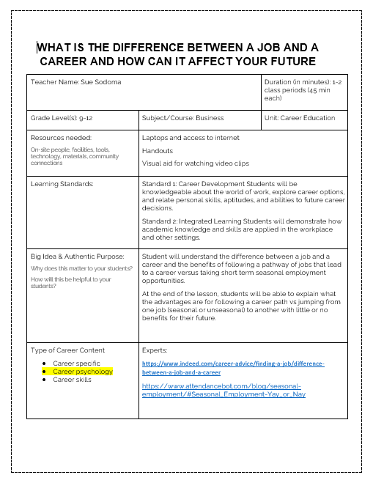
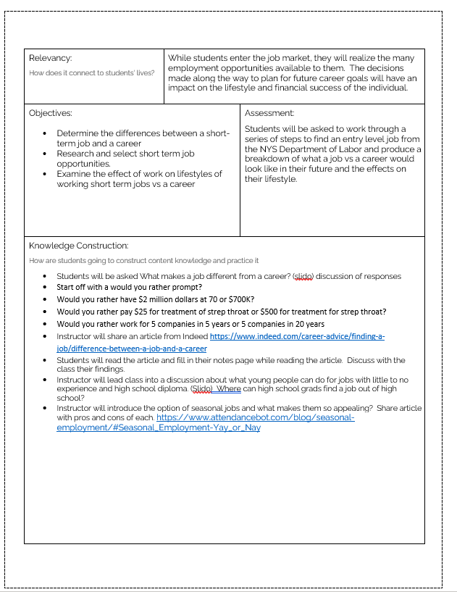

Slide 26
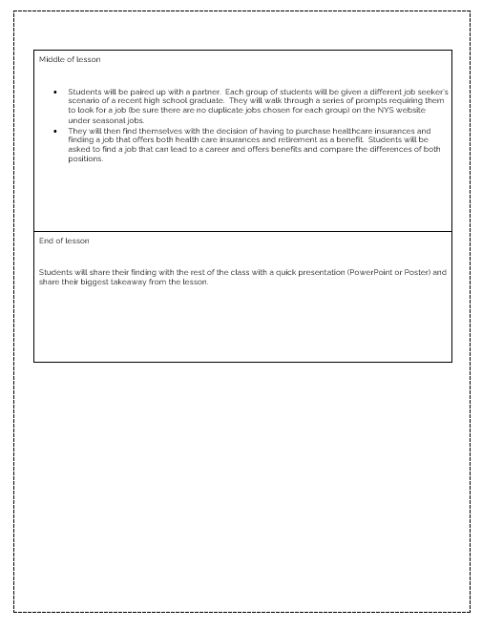
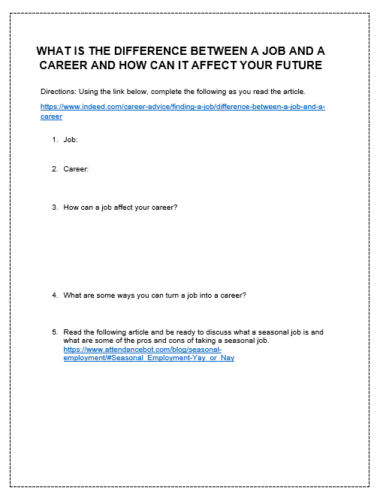

Slide 27
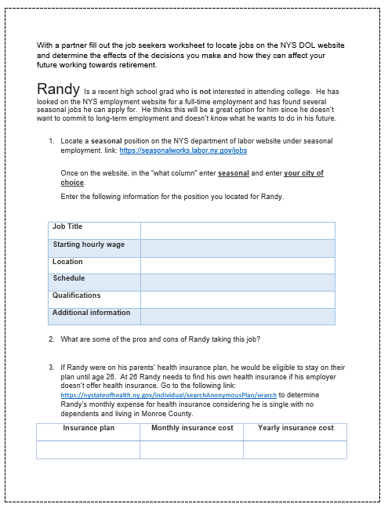
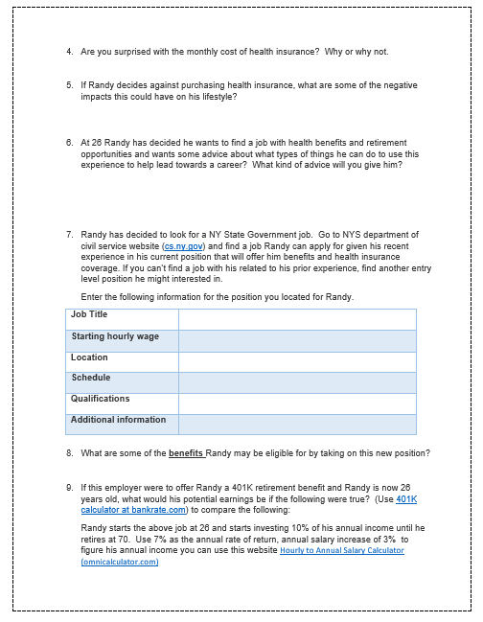

Slide 28
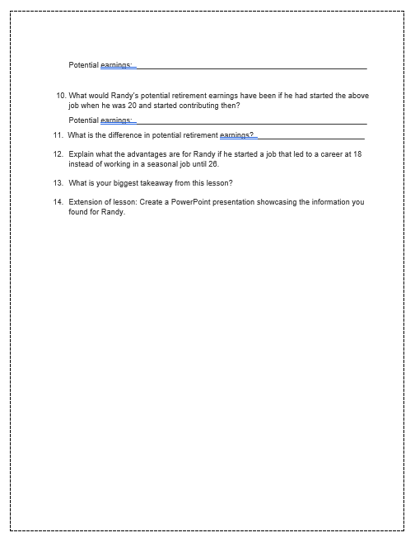

Slide 29
Lesson Plan 2
Where can I find a job after I graduate?

Slide 30
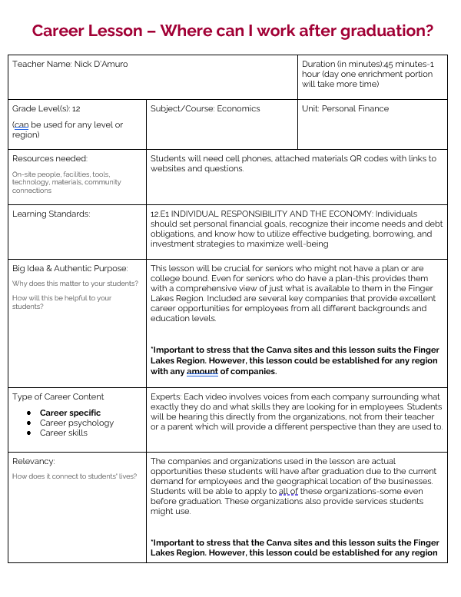
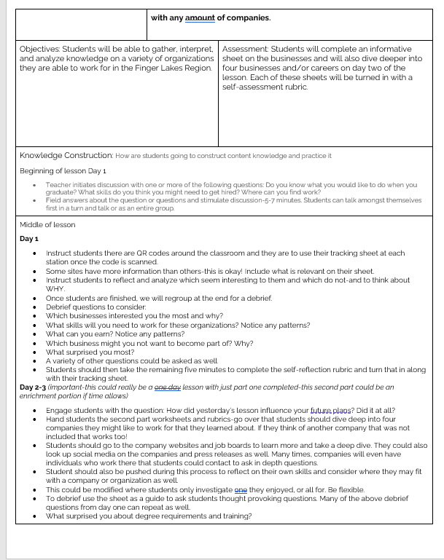
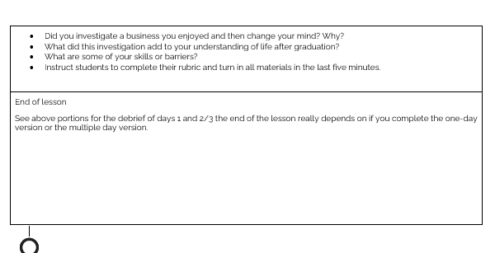

Slide 31
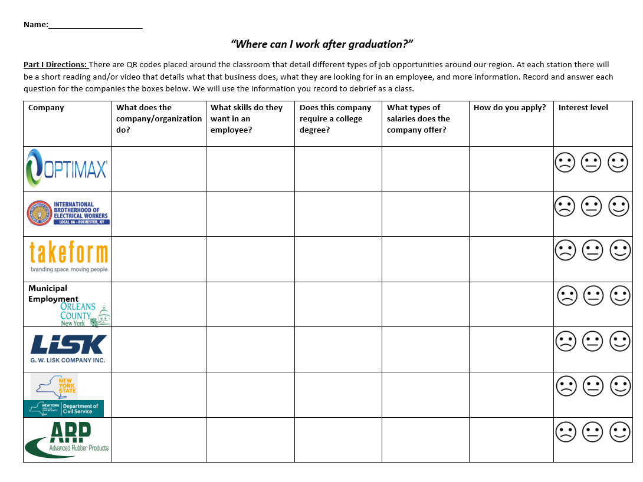
Inquiry based-ask the question seek to answer
Selection of companies we visited
Answered specific questions we asked
Each business has a QR code around the room
Students use this tracking sheet
Debrief

Slide 32
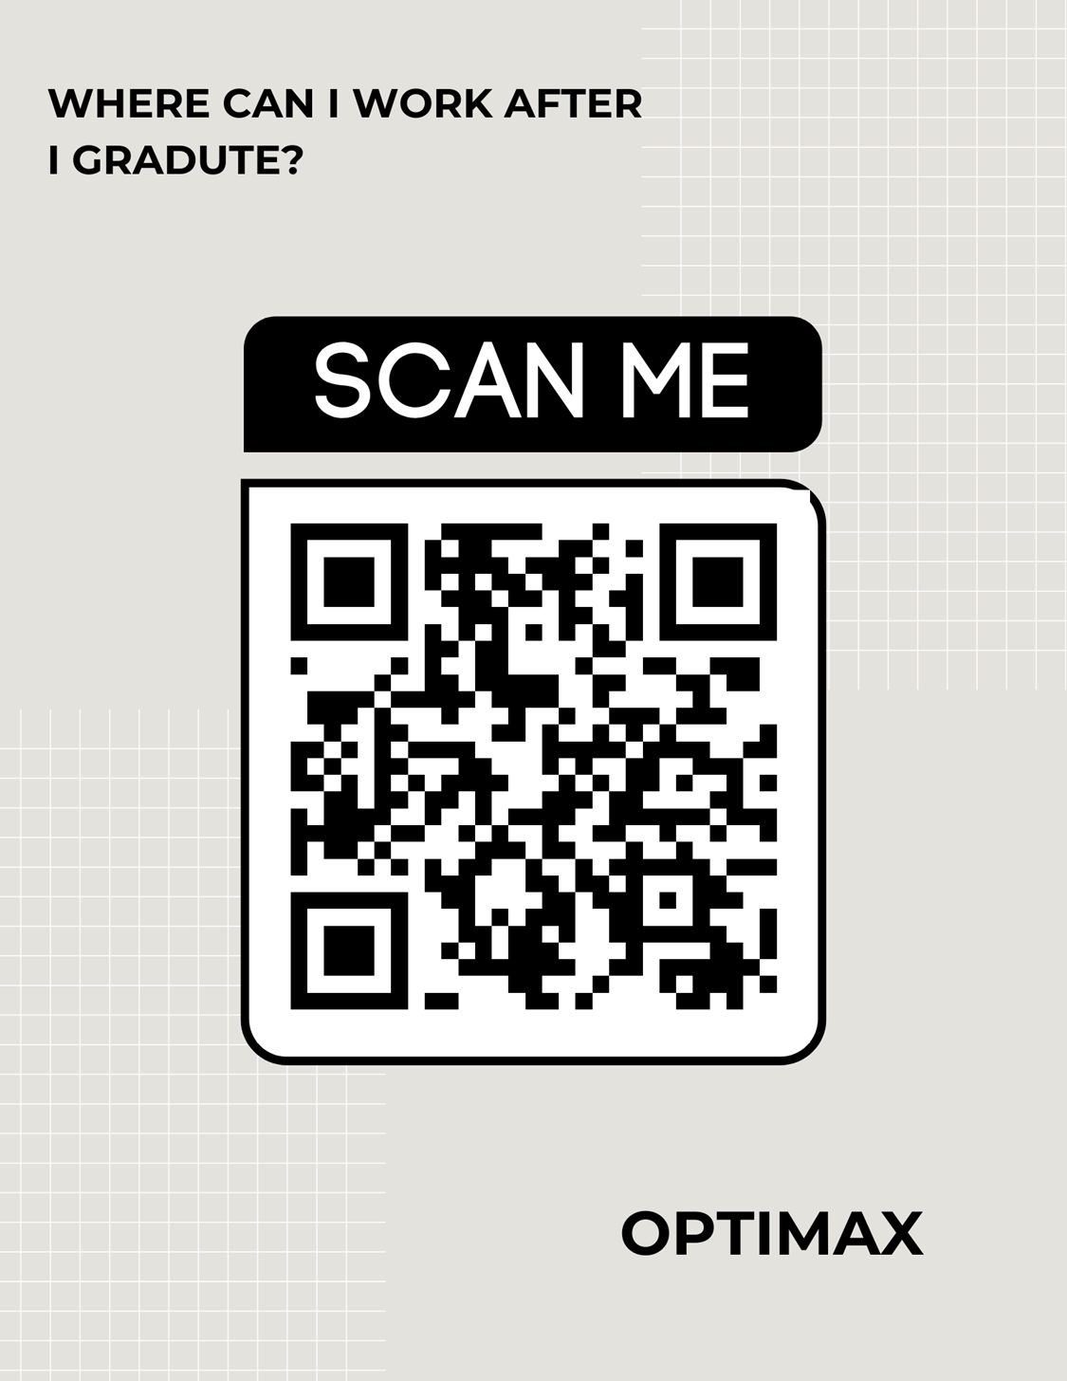

Slide 33
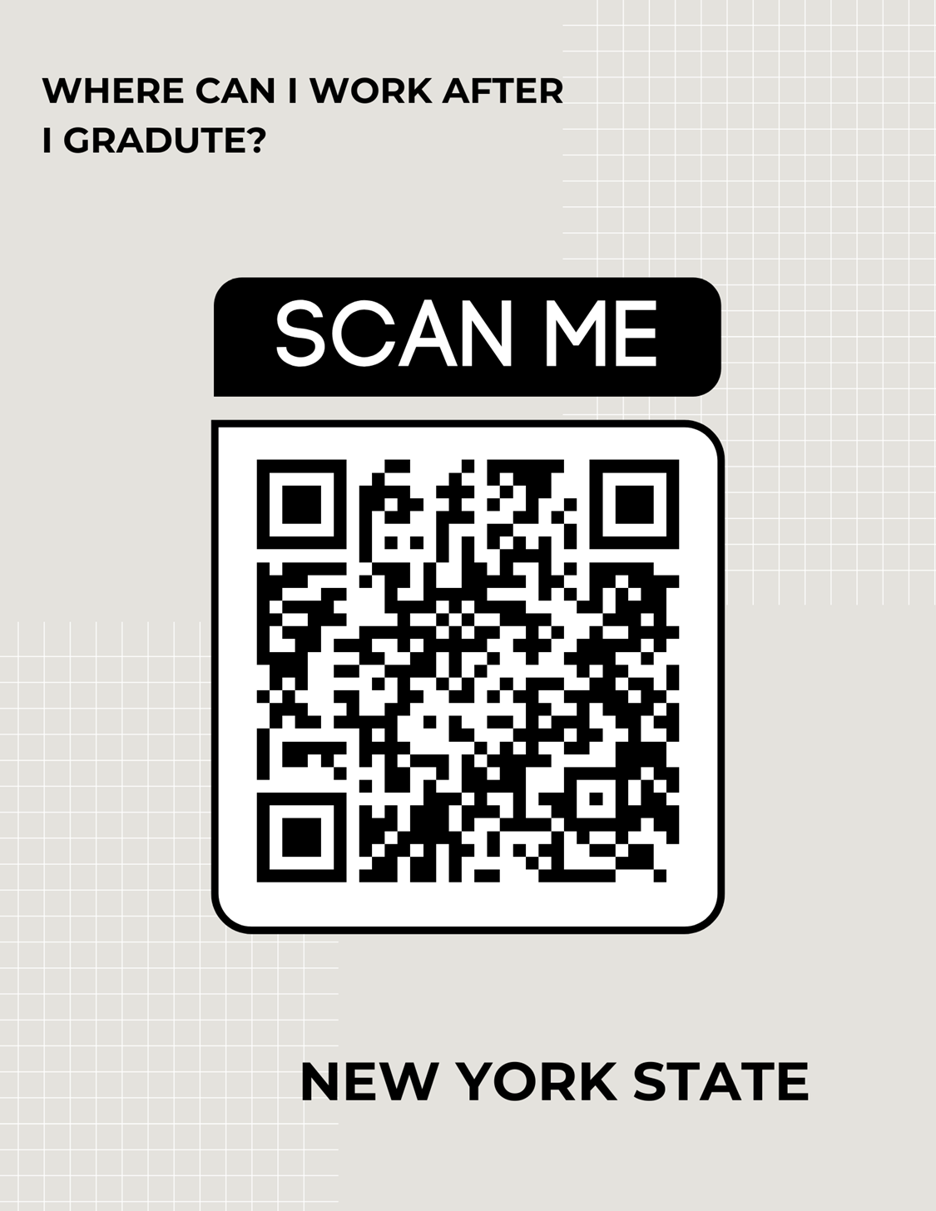
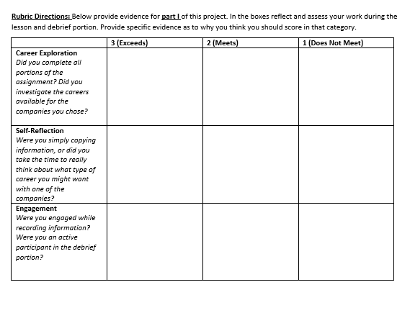

Slide 34
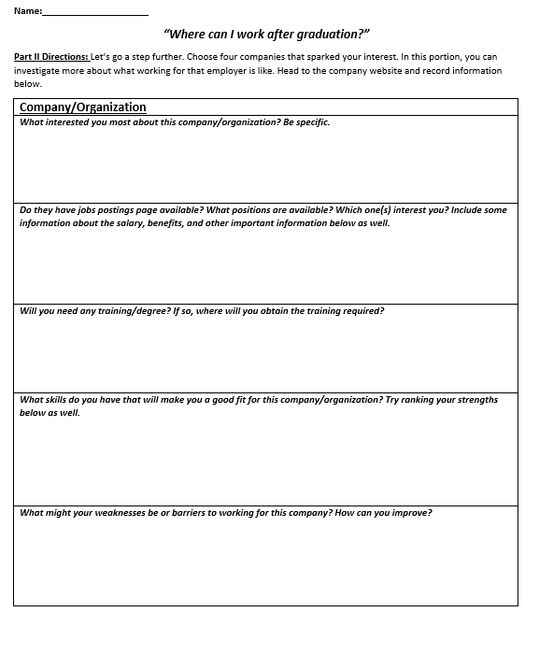
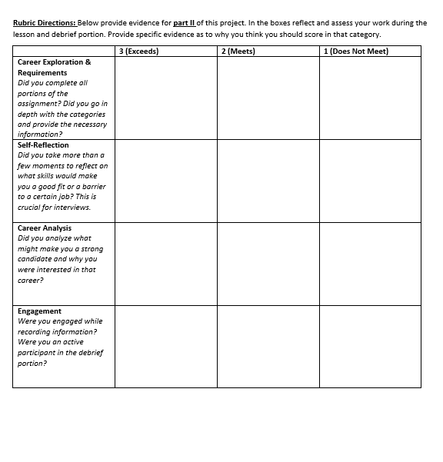
Potential for day 2-3 enrichment
Students choose 2-4 deeper dive
Like part I self-reflection rubric with debrief

Slide 35
Lesson Plan 3
Soft Skills/Interview

