Slide 1
State Workforce Investment Board (SWIB) Quarterly Meeting
^{October 5, 2023}
^{1:00pm - 3:00pm}
Location: NYS Museum, Meeting Rooms A & B
^{Albany, NY}
^{Governor Kathy Hochul}

Slide 2
Welcome and Introductions

Slide 3
SWIB Orientation

Slide 4
SWIB Orientation
WIOA Overview
Public Workforce System
SWIB Composition
SWIB Responsibilities
Ethics Compliance
Annual Requirements

Slide 5
Job Seeker/Business Survey Presentation

Slide 6
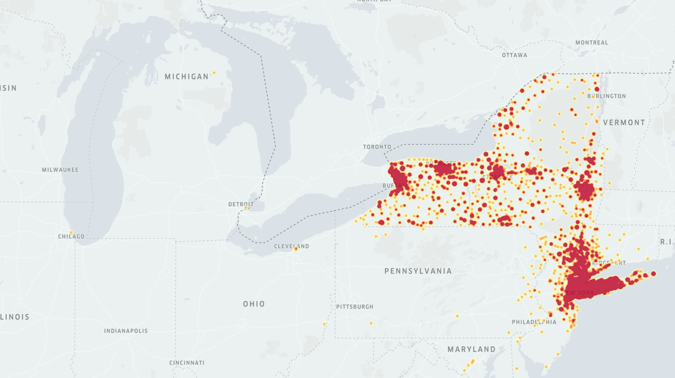
Survey Results
2021, 2022 & 2023
Business Surveys: 8,500 responses
Job Seeker Surveys: 20,200 responses

Slide 7
Business Surveys
Businesses are still struggling to attract workers
Major need for skilled trades awareness and training
Competition for limited talent pools is driving the market

Slide 8
Future Planning (1-2 years)
Digital Automation (Statewide, All Industries) | % |  | Robotic Automation (Statewide, All Industries) | %
Yes | 26% |  | Yes | 10%
No | 74% |  | No | 90%
Space Needs (Statewide, All Industries) | 2021 | 2022 | 2023
Reducing physical footprint | 7% | 5% | 7%
Increasing physical footprint | 17% | 21% | 21%
Stay the same | 76% | 60% | 55%
Undecided |  | 14% | 17%

Slide 9
Rank your top business challenges
Challenge (Statewide, All Industries 2023) | %
Attracting new workers | 76%
Inflation | 54%
Retaining current workers | 49%
Government regulations | 37%
Hiring / Maintaining a diverse staff | 31%
Supply chain challenges | 29%
Quiet quitting | 27%
Keeping up with customer demand | 23%
Training current staff | 22%
Staying competitive compared to other states | 19%

Slide 10
Finding Talent: Hard to Fill Positions
Position (Statewide, All Industries 2023)
1. Teacher |  | 16. Engineer
2. Laborer |  | 17. Project Manager
3. CDL Driver |  | 18. Carpenter
4. Administrative |  | 19. Licensed Practical Nurse
5. Sales |  | 20. Machinist
6. Accountant |  | 21. Machine Operator
7. Registered Nurse |  | 22. Cleaner
8. Manager |  | 23. Housekeeper
9. Mechanic |  | 24. Maintenance Technician
10. Warehouse Worker |  | 25. Assembler
11. Direct Support Professional |  | 26. Quality Control
12. Customer Service Representative |  | 27. Information Technology
13. CNC Machinist |  | 28. Case Manager
14. Electrician |  | 29. Driver
15. Cook |  | 30. Social Worker

Slide 11
Common skills lacking among job applicants and new employees
Non-Technical Skills (Statewide, All industries) | 2021 | 2022 | 2023
Self-motivation | 64% | 70% | 61%
Communication skills | 66% | 52% | 56%
Problem-solving/critical thinking | 63% | 48% | 52%
Timeliness/attendance | 51% | 55% | 51%
Attention to detail | 58% | 50% | 46%
Time management | 44% | 32% | 32%
Ability to take criticism | 40% | 31% | 27%
Personal awareness | 34% | 27% | 26%
Teamwork | 31% | 24% | 21%
English skills/grammar | 31% | 19% | 21%
Customer service | 24% | 19% | 20%
Conflict management | 33% | 17% | 18%
Basic math skills | 30% | 15% | 17%

Slide 12
Common skills lacking among job applicants and new employees
Technical Skills (Statewide, All industries) | 2021 | 2022 | 2023
Basic computer use / computer literacy | 47% | 44% | 48%
Software proficiency in Excel | 39% | 32% | 34%
Email | 19% | 19% | 22%
Mechanical technical / engineering | 23% | 19% | 22%
Software proficiency in Word | 23% | 17% | 19%
Data analysis | 15% | 16% | 19%
Typing | 19% | 16% | 18%

Slide 13
Barriers that prevent you from hiring a candidate or prevent them from taking a job
Barrier (Statewide, All Industries 2023) | %
Lack of experience | 52%
Self-motivation, initiative | 45%
Gap in salary and wage expectations | 43%
Transportation | 35%
Insufficient education/training | 35%
Scheduling | 28%
Child care | 26%

Slide 14
Finding Talent
Popular Recruitment Tools (Statewide, All industries, 2023) | % |  | Most Successful Recruitment Tool (Statewide, All industries, 2023) | %
Word of mouth / Networking through current employees / Referrals | 78% |  | Word of mouth / Networking through current employees / Referrals | 56%
Indeed | 73% |  | Indeed | 52%
Company website | 63% |  | Company website | 20%
NYS Dept. of Labor/NYS Job Bank | 52% |  | Third-party recruiter/head-hunter/staffing firm | 15%
Facebook | 45% |  | Facebook | 13%
LinkedIn | 40% |  | LinkedIn | 12%
Third-party recruiter / staffing firm / head-hunter | 32%
In-person career fairs | 32%
Direct campus recruiting/college fairs | 27%
Handshake | 21%

Slide 15
Training Desired, but Not Provided
Training Desired, but Not Provided (Statewide, All industries, 2023) | %
Management/leadership development or training | 28%
Mentoring/coaching | 26%
On-the-job training | 24%
Technical training | 24%
Job shadowing | 18%
In-house online learning/professional development | 15%
Third-party online learning/professional development | 14%
Lunch-and-learns or similar programs | 14%
Registered Apprenticeship programs | 13%

Slide 16
Job Seeker Surveys
Workers’ needs and expectations have shifted
Lack of professional networks, experience and credentials limit growth
Significant need for training and upskilling

Slide 17
What work options/incentives would you like employers to offer?
Incentive (Statewide, 2023) | %
Ability to work remotely full-time | 36%
Paid time off | 35%
Higher pay / higher starting pay | 33%
Health insurance | 33%
Ability to work remotely some of the time | 33%
Flexibility to choose my own hours | 30%
Ability to only work during the week | 27%
Fewer days of work per week with same overall pay | 24%
Ability to work early in the morning | 21%
Retirement account | 17%

Slide 18
Barriers to Employment
Barrier (Statewide, 2023) | Mild | Severe
I don't have enough experience in the field | 29% | 10%
I don't have a large professional network | 29% | 18%
I don't have the right degree, certificate or credential | 28% | 16%
I don't have enough modern / digital skills | 27% | 10%
I face discrimination due to my age | 27% | 21%
I have insufficient education or training | 27% | 10%
I have gaps in employment | 25% | 10%
I'm unable to practice for potential job interview questions | 19% | 6%
I'm unable to create cover letters and resumes | 18% | 6%
I'm unable to access technology to work remotely | 16% | 7%
I don't have access to reliable transportation | 15% | 7%
I have a disability | 13% | 5%
I'm unable to access the Internet to search for jobs | 11% | 3%
I don't have a driver's license | 10% | 11%

Slide 19
Barriers to Additional Education
Barrier (Statewide, 2023) | Mild | Severe
I don't know where to start | 26% | 16%
I don't know what I need | 22% | 13%
Lack of available programs | 20% | 14%
I'm worried it will be too difficult | 20% | 10%
Cost | 19% | 37%
Current loan debt | 13% | 19%
Child care / family obligations | 12% | 9%
Don't want to commit the time | 12% | 4%
Can't give up job at this time | 11% | 14%

Slide 20
Top Trainings Desired (Statewide, 2023)
1. Digital Skills |  | 13. Digital Marketing
2. Information Technology |  | 14. Management
3. Excel |  | 15. Electrical
4. Administrative |  | 16. Construction
5. CDL |  | 17. Culinary
6. Health Care |  | 18. Real Estate
7. Accounting |  | 19. Teaching
8. Project Management |  | 20. CNA
9. Medical Coding/Billing |  | 21. Cybersecurity
10. Security |  | 22. Coding
11. Microsoft Office |  | 23. Customer Service
12. Nursing |  | 24. Home Health Aide

Slide 21
Questions / Discussion

Slide 22
Asylum Seekers

Slide 23
Workforce Development Planning and Discussion

Slide 24
Governor’s Objectives

Slide 25
Governor’s Objectives
Creating a statewide workforce strategy document;
Producing and implementing a new technology tool to help businesses, training and education providers, and individuals navigate workforce resources;
Aligning efforts of training providers and funders across the workforce development ecosystem;
Developing common success metrics;

Slide 26
Governor’s Objectives
Implementing tracking and reporting requirements;
Articulating best practices and identifying opportunities for integration into new or existing workforce development programs;
Engaging industry on talent needs and opportunities;
Aligning regional workforce development stakeholders;

Slide 27
Governor’s Objectives
Improving access to quality jobs and career growth opportunities for marginalized and underrepresented communities; and
Designing new materials to help the public navigate the state’s workforce development and funding opportunities.

Slide 28
State Plan Priorities

Slide 29
Draft State Priorities
Priority 1: Ensure training programs in NYS stay in line with the needs of businesses
Priority 2: Support all job seekers, especially those with barriers to employment, in obtaining relevant skills, accessing support services, and connecting to jobs

Slide 30
Draft State Priorities
Priority 3: Attract, support, and develop businesses in promising and priority industries
Priority 4: Align workforce resources and data collection, and hold System partners accountable to standardized success measures

Slide 31
Draft State Priorities
Priority 5: Support existing workers to ensure they remain competitive throughout their career
Priority 6: Strengthen the long-term pipeline of workers to support the future of work

Slide 32
NYS Combined Plan Process

Slide 33
Combined State Plan
Requirement under WIOA
Core Partners
Additional Partners
Full Plan every four (4) years
Modification every two (2) years
SWIB Role

Slide 34
Combined State Plan
Regarding the industry sectors/occupations you represent, what are some of your employment needs?

Slide 35
Combined State Plan
Industry/sector partnerships and career pathways are proven strategies for improving labor market outcomes and economic mobility for working people, and in particular, people with low incomes and people of color. What are the most valuable industry/sector partnerships and accessible career pathways you utilize or are aware of, and why do they work?

Slide 36
Combined State Plan
What are your businesses or organizations doing to promote and develop inclusive training, hiring, and career advancement strategies? Where do you see opportunities to advance equity?

Slide 37
Combined State Plan
What relationships, if any, does your business or organization currently have with state entities that can assist with business services and/or training for your employees?

Slide 38
Next Steps & Wrap Up

Slide 39
Next Steps & Wrap Up
Travel Reimbursement
Follow-Up Survey
Future Meetings and Wrap-Up

Slide 40
Adjournment

Slide 41
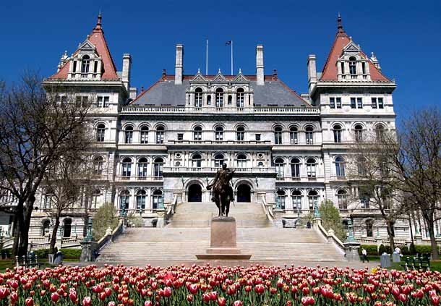
Thank you!
SWIB@labor.ny.gov

