Slide 1
Providing Language Access in Career Centers
February 11, 2020

Slide 2
What is Language Access?
Notes:
What is Language Access?
On October 6, 2011, Governor Cuomo issued Executive Order 26, which directed state agencies to provide language assistance services (translation and interpretation) to English Language Learners. English Language Learners are identified in a Language Access Plan developed by each agency.
Under the Workforce Innovation and Opportunity Act (WIOA) signed into law in 2014, English Language Learners are identified as customers with a barrier to employment and should receive priority of service for individualized and training services.

Slide 3
Interpretation vs. Translation
Interpretation is spoken; Translation is written
Agencies should provide interpreters for any language
Vital documents should be translated into most widely used
Notes:
What is the difference between Interpretation versus translation?
Interpretation is spoken language while translation is written.
According to directives, agencies should provide an interpreter for any language needed. This service is primarily provided by phone. Agencies are also required to translate select vital documents into specific languages. The identified languages are those that agencies identify in their plans as the most widely used by English Language Learners who access their services.

Slide 4
What is Considered a Vital Document?
Intake & application forms
Written notices of rights
Notices of denials, losses or decreases in benefits/services
Notices of disciplinary action
Signs/notices of free language services
Notes:
What is considered a vital document?
The U.S. Department of Justice Language Access Assistance Guide states, “vital written documents include, but are not limited to:
consent and complaint forms;
intake and application forms with the potential for important consequences;
written notices of rights;
notices of denials, losses, or decreases in benefits or services;
notices of disciplinary action;
signs; and
notices advising English Language Learners of free language assistance services.”
﻿

Slide 5
Career Center Vital Documents
Career Center Registration Form – ES100
EEO Notices
RESEA Work Search UI Eligibility Questionnaire
Work Search Plan
Federal Bonding Fact Sheet
Notes:
Vital documents at the Career Center level consist of the Career Center registration form (ES100), EEO Notice, UI Eligibility Questionnaire, Work Search Plan and the Federal Bonding Fact sheet. You can find these forms on the internet and intranet translated in the following languages:
Spanish
Russian
Korean
Chinese
Haitian Creole
Polish
Bengali
The translated version of the ES 100 can be found on our public website by selecting Other Information and then Forms and Publications.

Slide 6
Vital Document Languages
Spanish
Simplified Chinese
Russian
Haitian-Creole
Korean
Polish
Bengali
Notes:
What are the languages into which agencies will translate vital documents?
Spanish
Chinese
Russian
Bengali
Haitian Creole
Korean

Slide 7
Language Access
Language Interpretation Service is good customer service and is FREE of charge
Don’t expect the customer to provide their own interpreter
Explore the possibility of bi-lingual staff via videoconferencing
Notes:
Language interpretation is the facilitating of oral or sign-language communication, either simultaneously or consecutively, between users of different languages.
The purpose of Language Interpretation Services is to ensure that all customers who are not proficient in English, receive – FREE OF CHARGE – the language assistance necessary to participate in and all Career Center programs, services and information.
Don’t expect the customer to provide their own interpreter.
Prior to utilizing contracted services, staff are reminded to explore and utilize bilingual staff, if available, as well as existing “language banks” of volunteers who are fluent and able to interpret in other languages.
Explore the possibility of bi-lingual staff assistance via videoconferencing. For example Dept. of Labor staff can use the Skype feature in Outlook to connect with bi-lingual staff across the state.

Slide 8
Language Access
DOL Language Bank can be found on the Intranet under Helpful Information
Ask the customer what method they are comfortable with
Notes:
The DOL language bank can be found on the Intranet under Helpful Information.
If appropriate ask the customer what method of interpreting services they are most comfortable with.

Slide 9
Services Available

Slide 10
Services Available to All Customers
Telephonic – Over the phone interpreters
In-person interpreters
Written Translation Services
Sign Language Interpreters
Every Career Center Manager has received instructions for the contracted vendors
Notes:
The three services are telephonic- over the phone interpreters, in-person interpreters including sign language interpreters and written translation.
Services are available for all One Stop Career Center staff to use. This includes DOL and NON-DOL staff such as WIOA staff, DSS staff, or any other partner staff in your office.
Written translation includes customer correspondence (email and letters)
Every Career Center manager and operator has received the Instructions for contacting the contracted vendors who provide these services.

Slide 11
Telephonic Services
Interpreting services in over 200 languages
Identify the language needed (from customer, Language ID Tool, or by Operator)
Request the language needed (or ask for help identifying language)
Provide the access code to the operator
Notes:
Using a telephonic interpreter offers speedy interpreting service in over 200 languages.
language interpretation services by telephone can be useful when non-English speaking customers visit a Career Center with questions or if a call is received from a non-English speaking customer. Staff may use the Language Identification Tool handout to initially respond to the non-English speaking customer.
All Career Center staff can contact Interpreting services directly. This includes both DOL AND non DOL staff. Currently our telephonic vendor is Language Line Solutions. As a best practice every staff person in the Career Center should have a Language Line Reference document on their desk. Included on the Language Line document is an access code. You will be required to provide these codes when calling the language line. Each center also has an assigned code.
Make sure your language reference document has your local code filled in.
The codes help us with our central billing and tracking the language needs of centers.

Slide 12
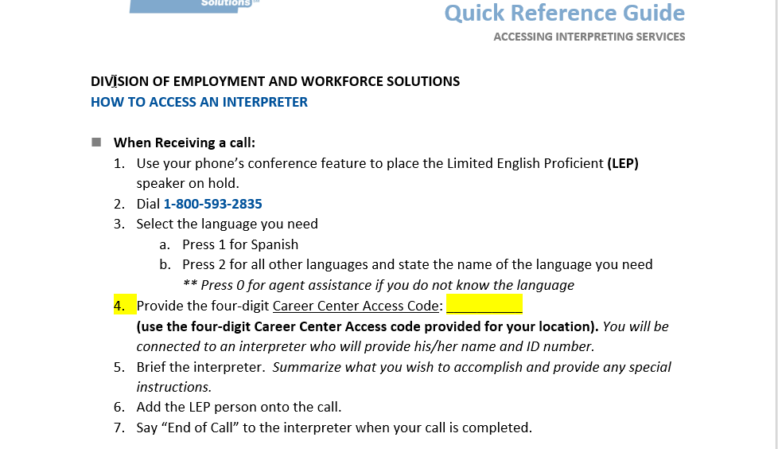
Notes:
This is a copy of the Quick Reference Document that all staff should keep at their desk.
Remember to fill in the Access Code for your location.

Slide 13
Telephonic Services
Hold while your operator is connected
You will be informed that the interpreter is “on the line” and be provided with their ID number
Explain the reason for the call to the interpreter
Say End of Call when the call is completed
Notes:
When the interpretation starts, make sure to speak directly to your non-English speaking customer. The interpreter will then interpret your questions into the customer’s native language as well as the customer’s responses back to you.
Say “End of Call” to the interpreter when your call is completed. (Your time will be automatically recorded by the Language vendor.)
Vendors will send an invoice to DOLs Accounts Payable unit. No additional procurement is required. The DEWS BEWO unit will verify that services were received. If the customer has an OSOS record the appropriate corresponding activity must be recorded.
One of my main functions in providing Language Access Support is to review these invoices and bills and compare them to the customers’ OSOS Records to ensure that Language Access Services were provided to the customer.

Slide 14
Working With the Interpreter
Briefly tell the interpreter the nature of the call
Speak directly (naturally, not louder) to the customer
Ask if the customer understands
Don’t ask for the interpreter’s opinion
Avoid jargon or technical terms
Notes:
When connecting with the telephonic interpreter, at the beginning of a call, briefly tell the interpreter the nature of the call. Provide specific instructions of what needs to be done or obtained.
Speak directly to the customer, not the interpreter and pause at the end of a complete thought.
Speak naturally not louder
Ask the customer if they understand
Do not ask for the interpreters opinion
Everything you say will be interpreted so be sure to avoid jargon or technical terms

Slide 15
Using Over the Phone Interpreters
Learn your phone system
Your interpreter will alert you of any sound issues on either end
Be patient
Plan for adequate time
Notes:
Make sure you know your systems capacity when working with a customer that will need language interpreting services. Speaker/microphone?
Remember that interpreted communication normally takes twice as long as communication in the same language so please be patient.
It is normal for interpreters to require clarification of unfamiliar terms occasionally. If your interpreter asks you to define a term, try to rephrase it in other words. The interpreter may have to ask the customer to clarify terms as well, but will let you know before addressing the customer in their language.

Slide 16
Consecutive Interpreters (In-person)
On-site interpreter services for Career Center services
Contact your primary vendor listed on the Consecutive Interpretive Services listing
Vendor will ask for the Purchase Order or Account number
Notes:
When making a future appointment for a customer to provide next step services, an in-person interpreter may be the most beneficial way to deliver quality services.
If you have lead time, arrange for an on-site interpreter to assist non-English speaking customers to participate in Career Center services, whether for mandatory or optional appointments and workshops. Some examples include - job search or résumé preparation or career counseling, rapid response services, etc
Career Center staff can contact the vendor directly to arrange for services. The vendor will ask for the PO- Purchase Order or account number and the customers name and OSOS ID number.

Slide 17
What to Expect
What is the role of the interpreter?
It is not the job of the interpreter to ensure the non-English speaker understands
Interpreter may not change the register/level of the language
Interpreter is not an advocate
Interpreters may not give any legal or medical advice
Interpreters should only convey what the Career Center staff or the non-English speaker actually say
Notes:
First I am going to explain what is NOT the role of the interpreter.
It is not the job of the interpreter to make sure that the non-English speaker understands.
The interpreter may not change the level of the language to allow the customer to understand what is being said.
The interpreter is not an advocate for the customer and should not try to "help" the customer. The interpreter is doing a service just by serving as a conduit for communication.
The interpreter must maintain the same level of language as the staff and the jobseeker regardless of whether or not the customer and/or the staff are knowledgeable of that language being utilized.
Interpreters may not give any legal or medical advice for any reason.
Interpreters should not communicate with the customer other than to relay what the Career Center staff say or what the customer wants to say.

Slide 18
Protocol for Interpreters
Interpreters should be clear about explaining his/her role
Interpreters should refer to themselves as “the interpreter”
Interpreters should be as unobtrusive as possible
Interpreters must interpret every word from all parties
Notes:
Before the assignment begins, the interpreter should be clear about explaining his or her role during the assignment to the non-English speaker and staff
The interpreter should refer to himself or herself as “the interpreter” and for the sake of professionalism remain neutral as a third party entity (e.g., “the interpreter requests that the Counselor restate the question”)
The interpreter should be as unobtrusive as possible. During the service the interpreter should only speak in response to questions and comments from the staff person or other relevant parties. The interpreters role is to interpret as clearly as possible a word for word account of everything that is spoken in any oral exchange.
The interpreter should be prepared for each assignment with a pad of notepaper, a pen or pencil and a decent dictionary for reference (just in case).
It is the interpreter’s job to interpret every word from all parties – the general meaning of each statement is not sufficient or acceptable.
The interpreter should remain as impartial and objective as possible. Engaging in outside conversation with customers and/or others is not appropriate during the contracted interpreting meeting time. It is the responsibility of the interpreter to relate all statements – all the time without becoming personally and/or emotionally involved.
Confidentiality is always assumed.

Slide 19
Top Languages in NYS
Spanish
French
French Creole
Italian
Yiddish
Indic languages (Hindi, Urdu)
Russian
Polish
Chinese
Korean
Arabic
NYC (5 counties)
Albany
Suffolk
Nassau,
Dutchess
Rockland
Westchester
Erie
Monroe
Onondaga
Notes:
These are the top languages used across New York State. You can see they are concentrated in the counties listed on your screen however there are pockets of diverse communities through out the entire state.

Slide 20
Highest Volume of English Language Learners
Manhattan
Brooklyn
Jamaica
White Plains
Hempstead
Hicksville
Spring Valley
Utica
Syracuse
Flushing
Bronx
Staten Island
Patchogue
Yonkers
Hauppauge
Peekskill
Rochester
Buffalo
Notes:
Even though these areas have the highest concentration of English Language Learners, a non-English speaker can come into any Career Center at any time so it is very important that ALL staff know how to use the Language Access Services.

Slide 21
Sign Language Interpreters
Contact the approved vendors the same way you would an in-person vendor
Contact primary vendor first, then secondary, tertiary vendor
If there is a need to utilize the tertiary vendor, please contact Ruth.Post@labor.ny.gov or at (518) 457-6690
Notes:
When scheduling a sign language interpreter, it is critical for you to get as much notice as possible and contact your primary vendor right away.
If your primary vendor is unavailable, then you can contact your secondary vendor.

Slide 22
Tips for Working With Sign Language Interpreters
Speak directly to your customer and not the interpreter
Maintain eye contact and speak to your customer in the first person (Ex: What is your name?)
Use plain English and speak clearly
Ask one question at a time
Allow the interpreter to finish before speaking
Notes:
Here are some tips for working with a sign language interpreter:
Maintain eye contact and speak to your customer in the first person (Example: “What is your name?” NOT “Ask her what her name is?”).
Use plain English and speak slowly and clearly.
Ask one question at a time.
Allow the interpreter to finish interpreting before speaking.

Slide 23
OSOS

Slide 24
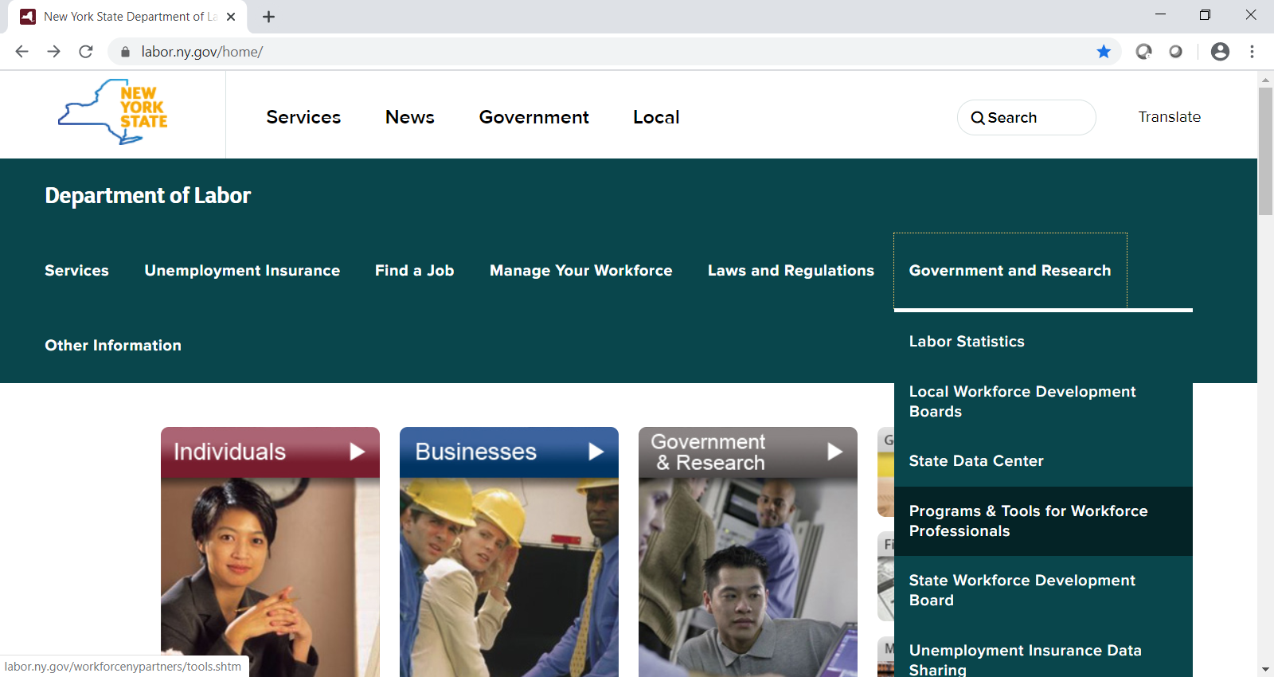
Notes:
Documentation
Documenting services provided to English Language Learners is critical. Under the workforce professional internet page you will find the OSOS guide on documenting Language Access.
Before we go through the OSOS slides in this presentation, I would like to take a minute to show you where you can access the OSOS Guide.
Go to the DOL webpage
Click on Government and Research
Then Click on Programs and Tools for Workforce Professionals

Slide 25
Notes:
Next Select Language Access
Here you will see links to the TA, the OSOS Guide, Posters, and Vendor information
This information is on our public website and therefore can be accessed by both DOL and non-DOL staff
The Language Identification Poster was emailed to you in the training announcement.
We are currently working on putting this information on the website as well as the waiver of Language Access Services.

Slide 26
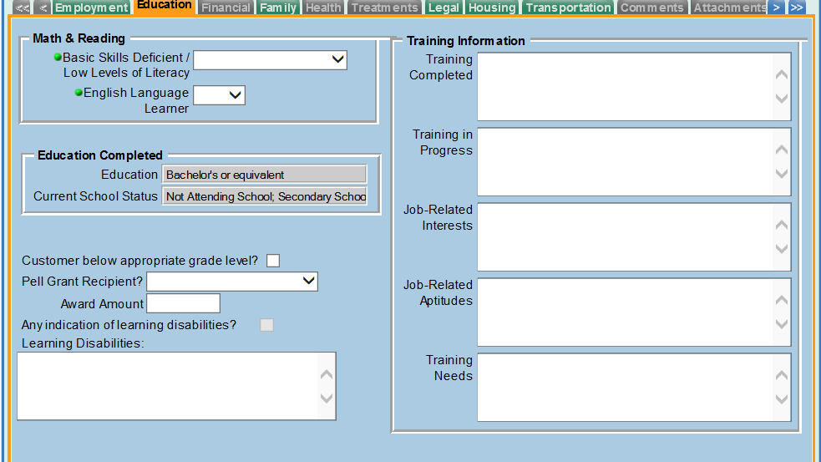
Notes:
Now let’s go back to our OSOS Slide.
Documentation includes identifying a customer as an English Language Learner.
This slide shows the Comp Assessment Tab. In order to document a customer as an English Language Learner, go to this tab and select, “Yes” next to English Language Learner and then select Save at the bottom

Slide 27
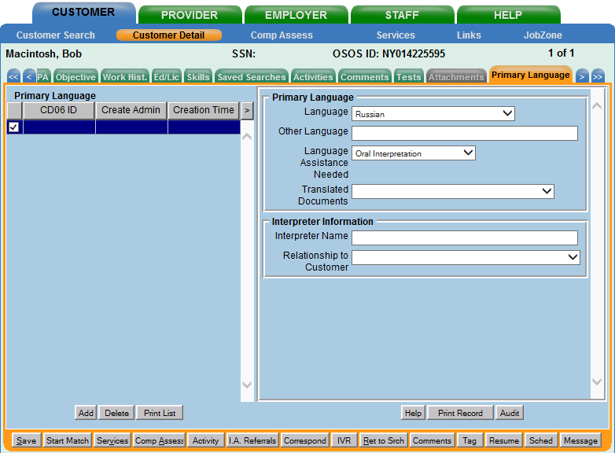
Notes:
Recording the customer’s Primary Language (slide)
Now we will select the Primary Language Tab.
Select- Add and the language fields will open
Select the language
Select the Language Assistance Needed

Slide 28
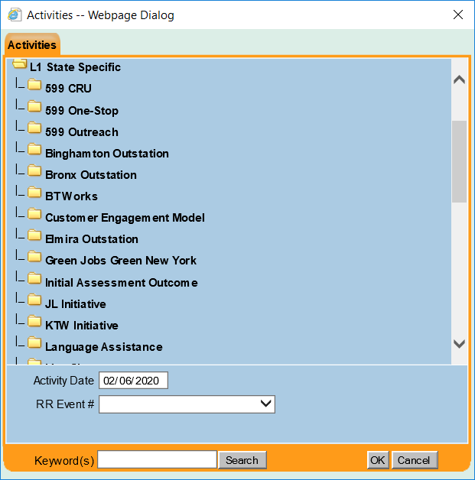
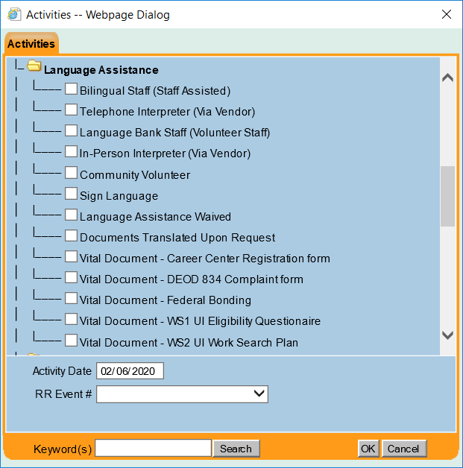
Notes:
Then we record the service provided (slide).
Select Activity at the bottom of the screen.
State Specific. Next select the Language Assistance folder
Select the Language Assistance that was provided and click save at the bottom.
Accurate documentation is used to provide good customer service, identifying a customer with a barrier as defined by WIOA, providing follow-up services and appropriate referrals, data for quarterly Language Access reports and federal reports, and an understanding of staffing needs for language parenthetics.

Slide 29
For More Information
Contact the Language Access Coordinator
Eric Denk 607-778-2836 Eric.Denk@labor.ny.gov
For vendor information and access codes DEWS.Reemploy@labor.ny.gov
Notes:
For more information contact the Language Access Coordinator
Eric Denk 607-778-2836 E-Mail: Eric.Denk@labor.ny.gov Or for vendor information and access codes, contact the DEWS.Reemploy mailbox
Here is the contact information for Eric and I. If you need any assistance or have questions, please feel free to contact either one of us.

